Slide 1
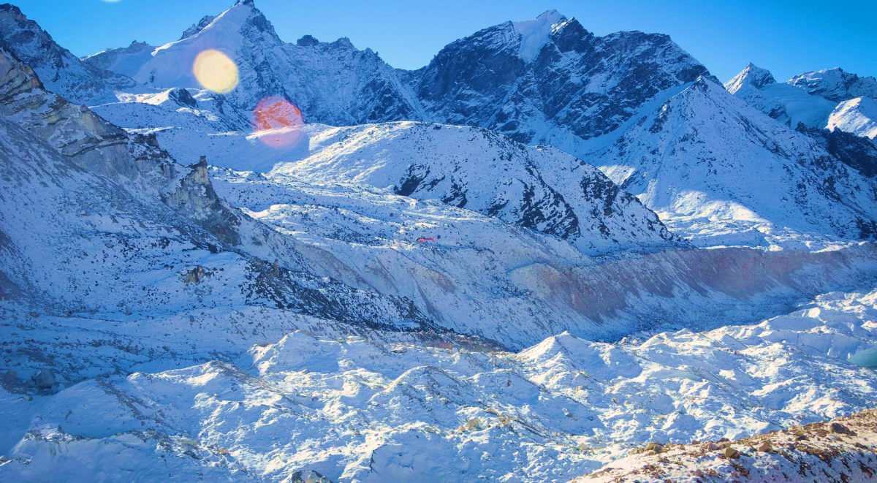

Analysis of environmental,
geographical and atmospheric factors on snow cover changes in the Himalayas
Presented by:
Mainack Paul, MStat Second Year, Roll-No: MD2111
Supervisor:
Dr. Sarbani Palit

Slide 2
Introduction
Glaciers are climate-sensitive components of the earth.
Glaciers are experiencing negative mass balance in Himalayas which is attributed to the rapid rise in temperature.
Rapid snow melting leads to glacier induced disasters. Yet, there exists a research gap relating to quantifying the melting rate and the causes behind it and its effects.
Aim
Mean : 60.17061
Q1 : 55.21
Q2 : 62.695
Q3 : 68.0825
POP : 75, 76 & 77

Slide 3
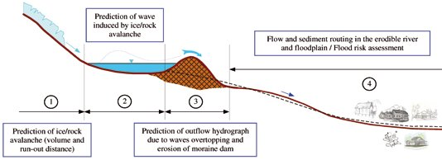
What are GLOFs?
Aim
A glacial lake outburst flood (GLOF) is a type of outburst flood caused by the failure of a dam containing a glacial lake.
Determination of possible hot spots of melting regions within a glacier body is a necessary step to understand such events.
Mean : 60.17061
Q1 : 55.21
Q2 : 62.695
Q3 : 68.0825
POP : 75, 76 & 77

Slide 4
Aim and Novelty
Octane Rating
Rapid snow melting leads to glacier induced disaster and thus, our main target is to model this melting of snow.
Melting depends on various topographic and climatic variables. In order to model the spatial and temporal heterogeneities within glaciers and produce an accurate forecast, it is necessary to evaluate all these effects together with their relative importance.
Fitting of various Machine Learning and Deep Learning models using the important factors, that we will use for prediction.
Comparing the models using various accuracy measures and then, suggest the best possible model.
Our present study have performed, to the best of our knowledge, the first-ever machine learning model for snow depth changes over moderate length times series data.
Aim
Mean : 60.17061
Q1 : 55.21
Q2 : 62.695
Q3 : 68.0825
POP : 75, 76 & 77

Slide 5
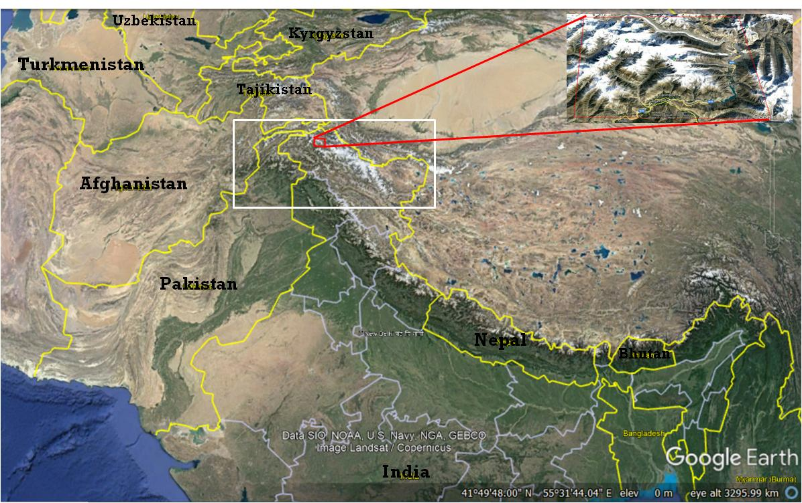
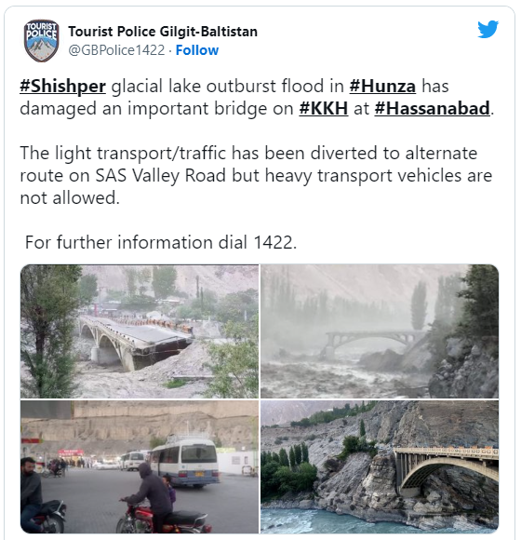
Study Area
Shishper Glacier (Hassanabad, Hunza Valley)
Repeated GLOF events related
to widespread destruction
at Shishper, Gilgit-Baltistan,
Karakoram Range
36°26.4′N , 74°40.9′E
Aim
Reported Dates (Last 5 years)
> May, 2017
> 22-23rd June, 2019
> 29th May, 2020
> 07th May, 2022

Slide 6
Topographical Variables
Roughness
Terrain
Ruggedness
Index
Topographic
Position
Index
Change in Snow Depth
Slope
Aspect
Elevation

Slide 7
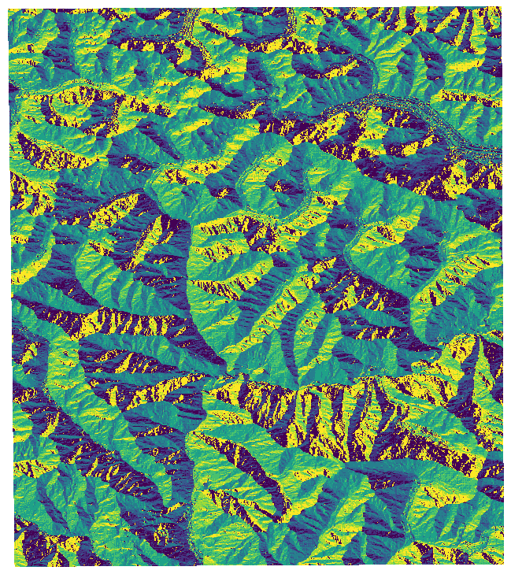
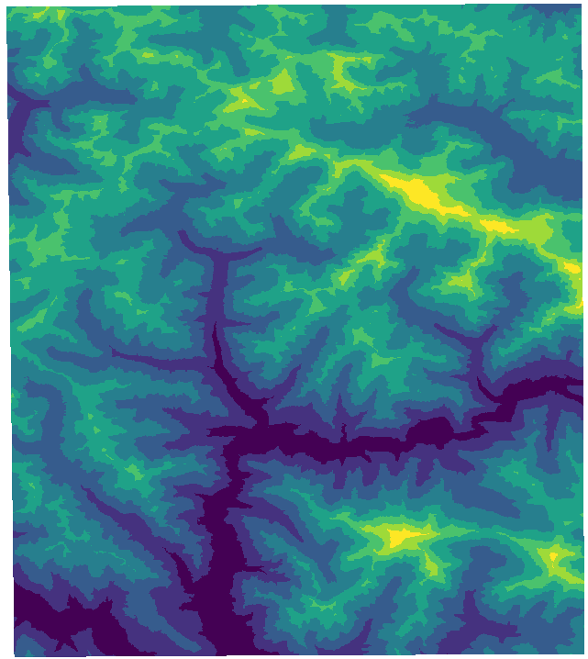
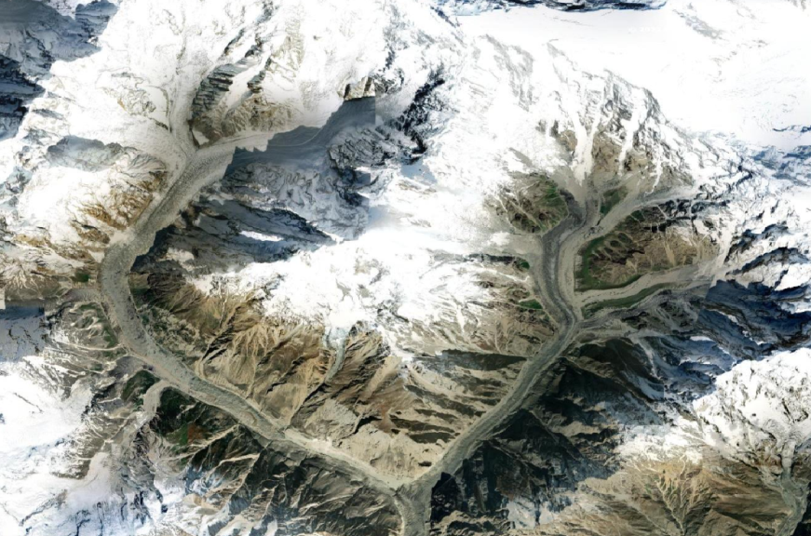
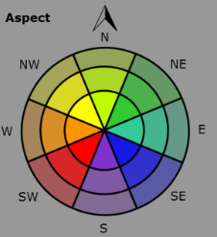
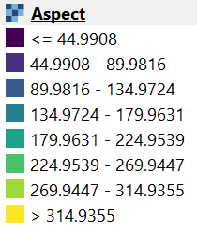
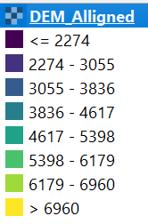
Topographical Variables
DEM: Digital Elevation Model
North: (0-22.5),(337.5,360)
North-East: (22.5-67.5)
East: (67.5-112.5)
South-East: (112.5-157.5)
South: (157.5-202.5)
South-West: (202.5-247.5)
West: (247.5-292.5)
North-West: (292.5-337.5)

Slide 8
Climatic Variables
Specific Humidity
Surface Pressure
Change in Snow Depth
Rainfall
Surface
Radiative
Temperature
Surface
Air
Temperature

Slide 9
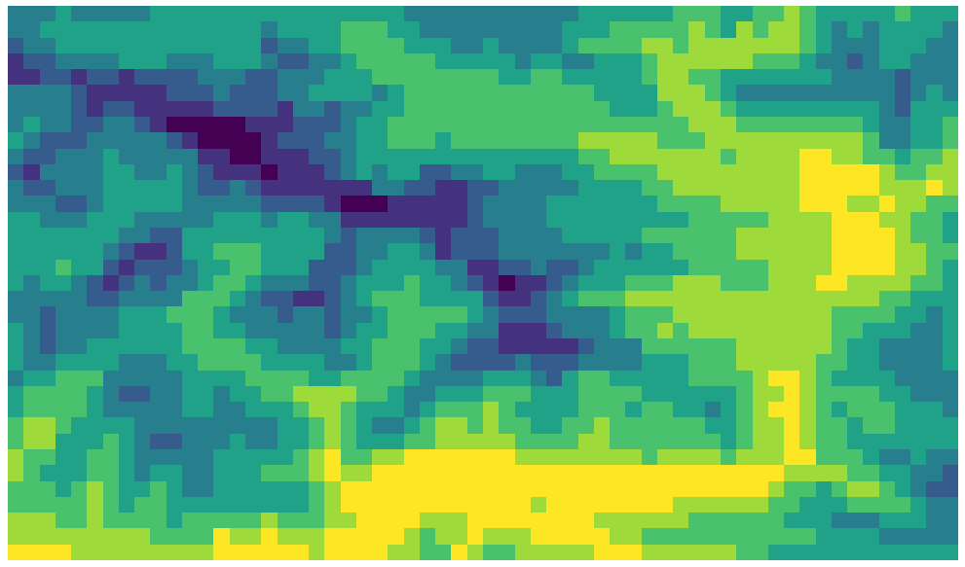
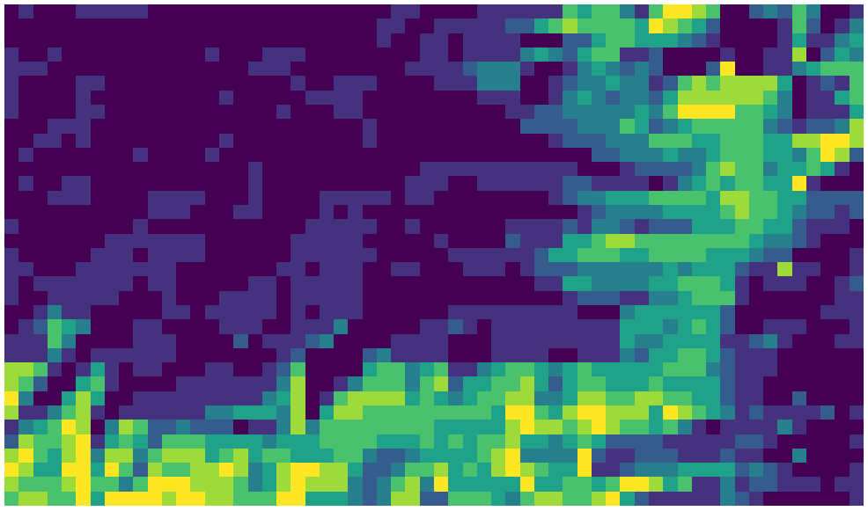
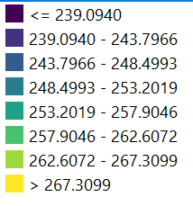
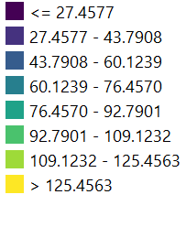
Climatic Variables
Surface Air Temperature
Surface Pressure

Slide 10
Project Timeline
Exploratory
Data Analysis
Statistical Inter-Relationships
Feature Selection
Final
Conclusion
01
02
03
04
05
06
07
08
Snow Melting during Winter
Cross
Correlation
Prediction and
Accuracy
Training and Testing Data

Slide 11
Training
and
Testing Data

Slide 12
The training dataset is used for training the machine learning model.
The testing dataset is used for evaluating the performance of the trained machine learning model.
In this project, we have worked on a daily time series data of 45 days from 1 April - 15 May, 2022 for each of the predictors and response.
For each time point, we have 2220 spatial data points which are chosen in such a way that spatial correlation is negligible.
We have divided the spatial points with respect to elevation since elevation is one of the most significant topographical variable (result got from midsem report).

Slide 13
We have removed Rainfall from our analysis since it has come the least significant among all variables (result got from midsem report).
We have created 5 groups of elevation: 3000-4000m, 4000-5000m, 5000-6000m, 6000-7000m and finally 7000-8000m.
We have calculated lags for the variables elevation-wise which will be used for our final time-series modelling.
The first 37 data points, we have taken as training data and the last 8 points as the testing data for our final time-series modelling.

Slide 14
Exploratory
Data Analysis
Critically performing initial investigations on data to discover patterns, anomalies using summary statistics and graphical representations

Slide 15
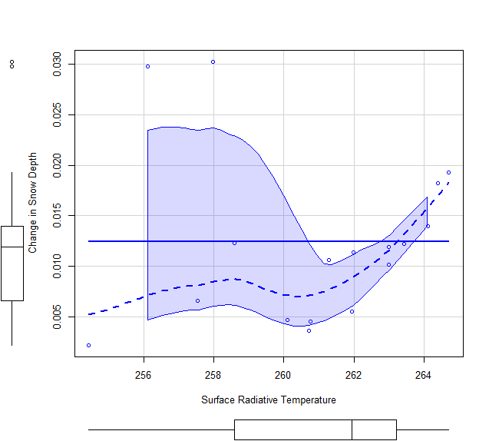
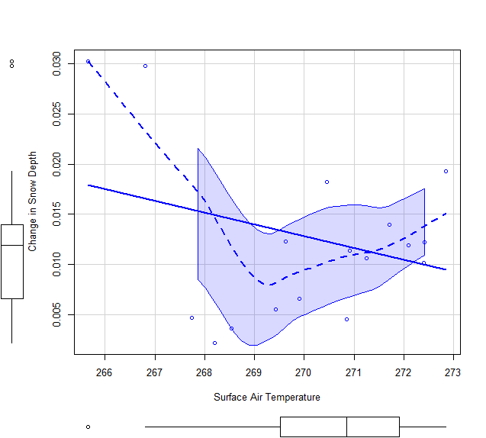
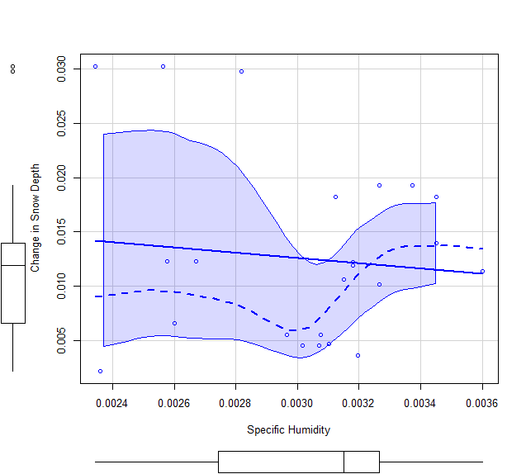
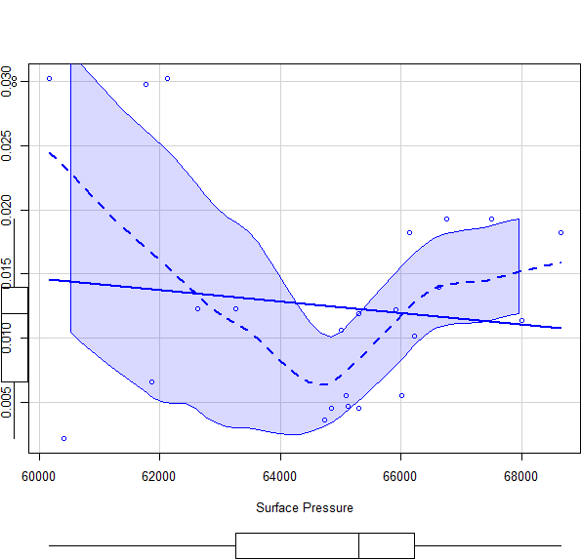
ELEVATION
3000-4000m

Slide 16
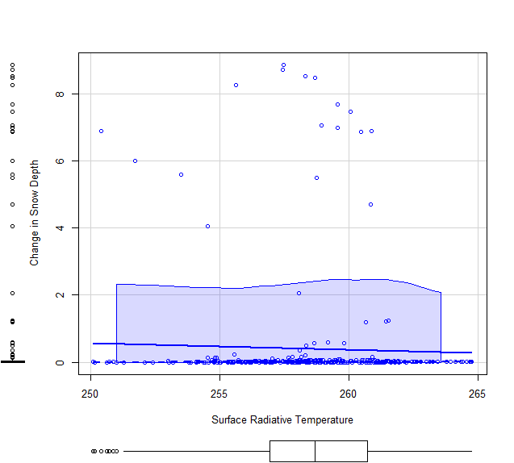
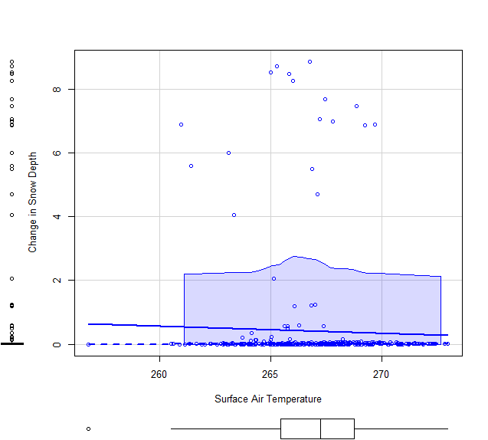
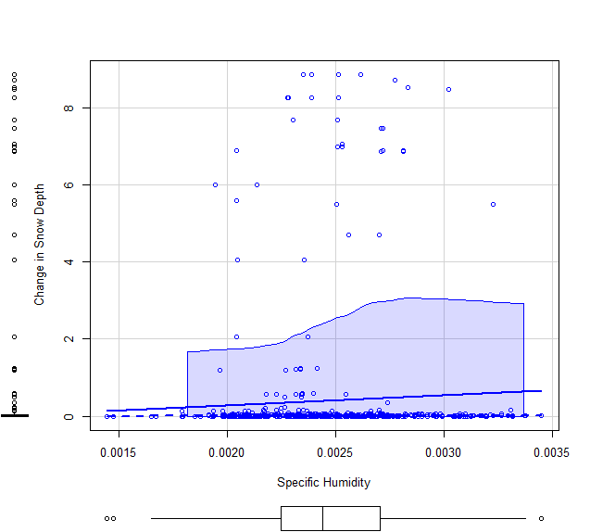
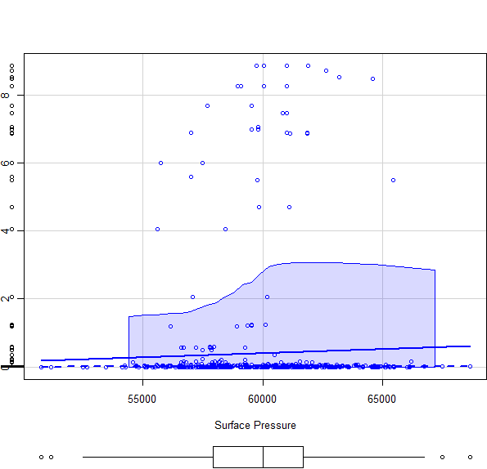
ELEVATION
4000-5000m

Slide 17
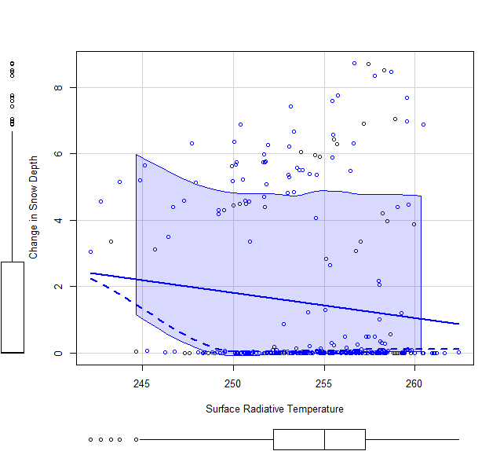
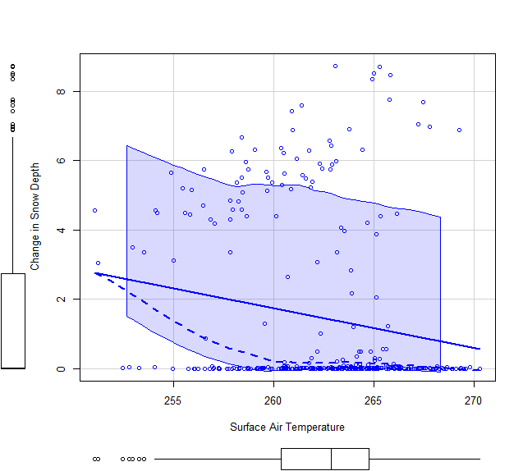
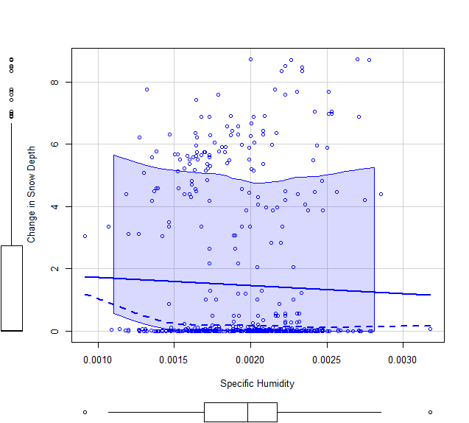
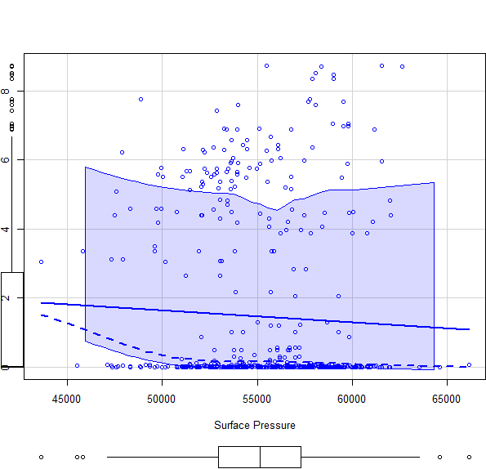
ELEVATION
5000-6000m

Slide 18
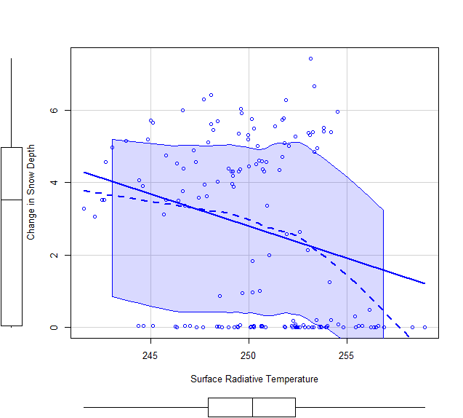
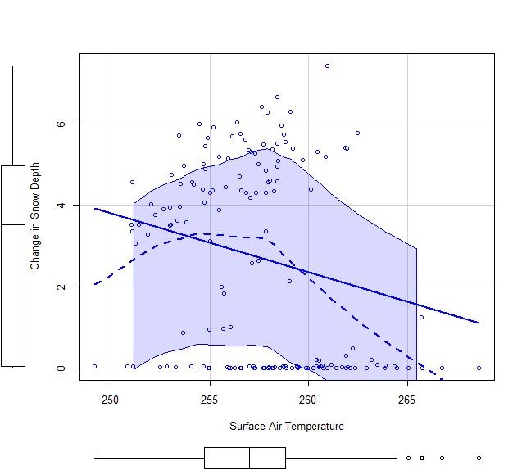
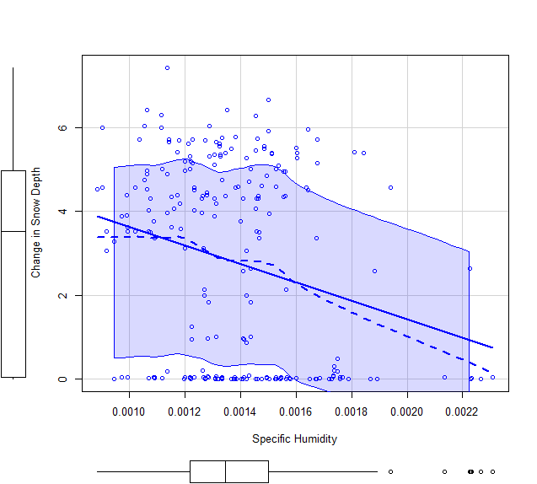
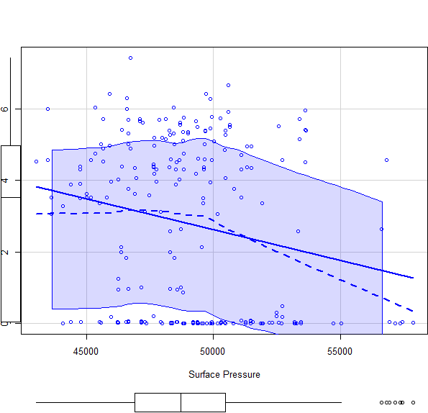
ELEVATION
6000-7000m

Slide 19
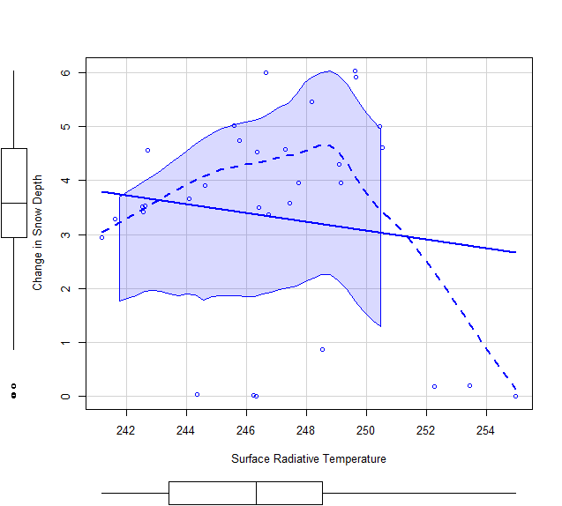
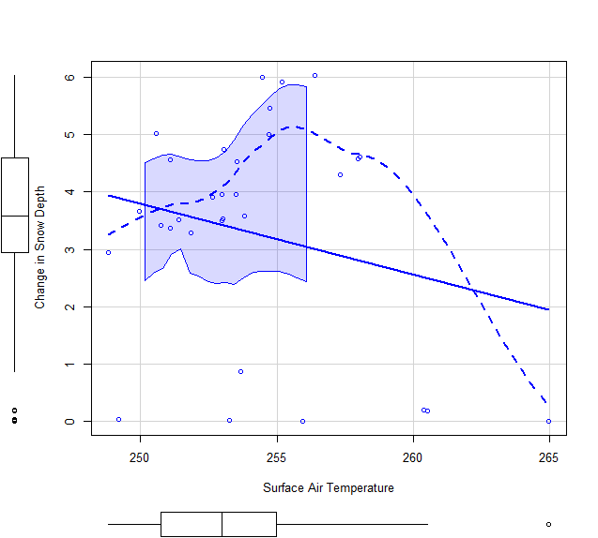
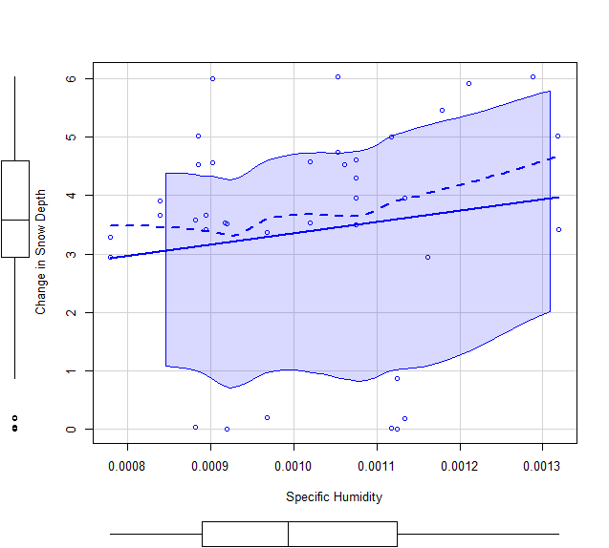
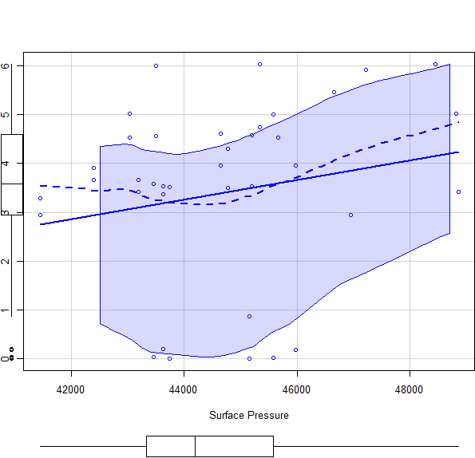
ELEVATION
7000-8000m

Slide 20
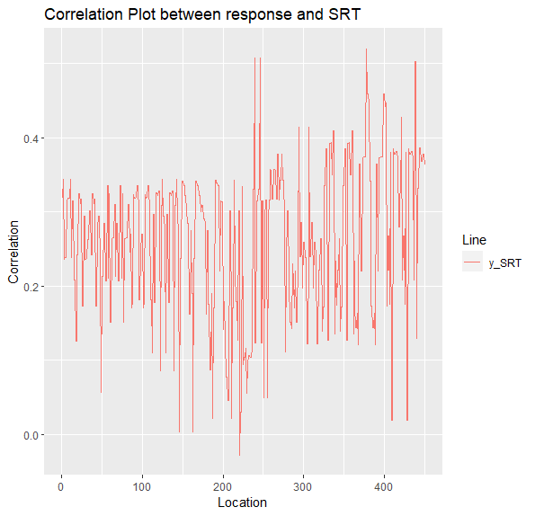
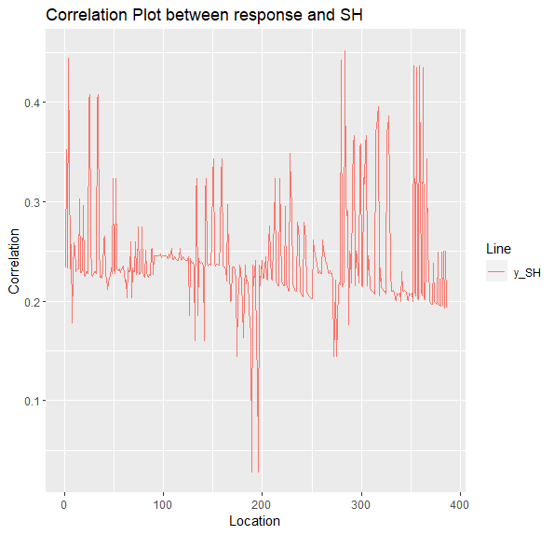
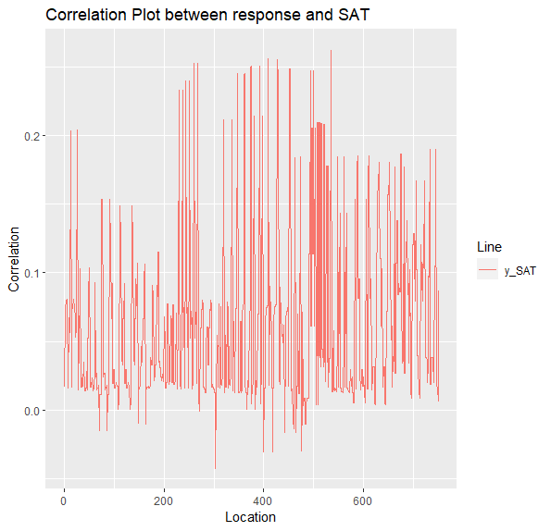
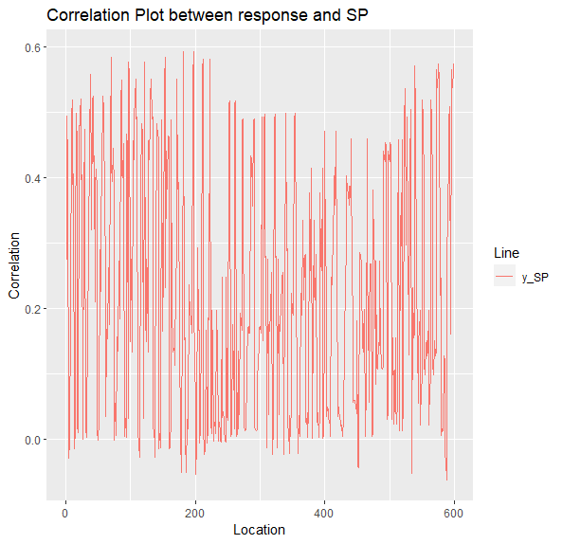
Correlation plots between
response and predictors

Slide 21
Snow Melting
During Winter

Slide 22
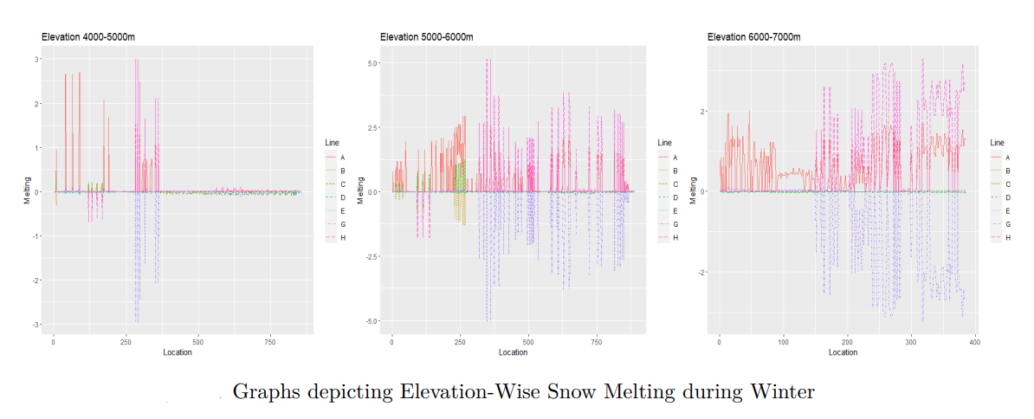

Slide 23
We have done our data analysis intensively for both summer and winter season but we will report mainly the analysis of the summer season.
The reason is that, in winter, we found out that there is no significant melting in a small interval of time, that can lead to disaster.
Also, not much events regarding GLOF has been observed in this region during winter.

Slide 24
Statistical
Inter-Relationships

Slide 25
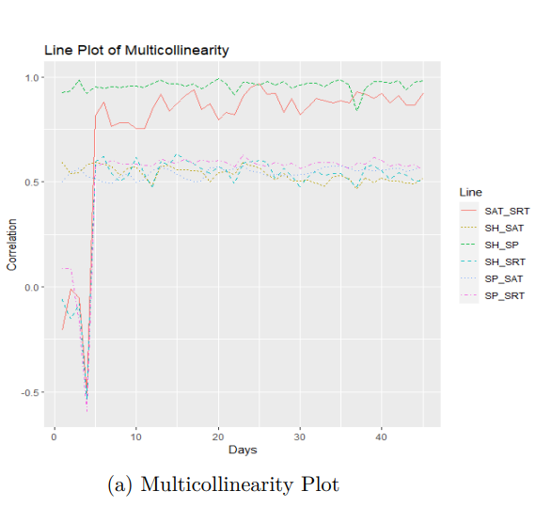
Surface Pressure-Specific Humidity pair has the highest correlation.
Checked multicollinearity once by taking the whole dataset and also elevation- wise.
Each of them have same results.

Slide 26
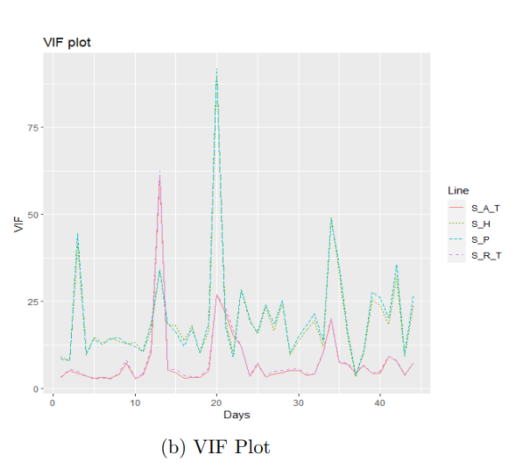
Surface Pressure has the highest VIF.
Checked VIF once by taking the whole dataset and also elevation-wise and all are having same results.
Hence, we have removed Surface Pressure from our analysis.

Slide 27
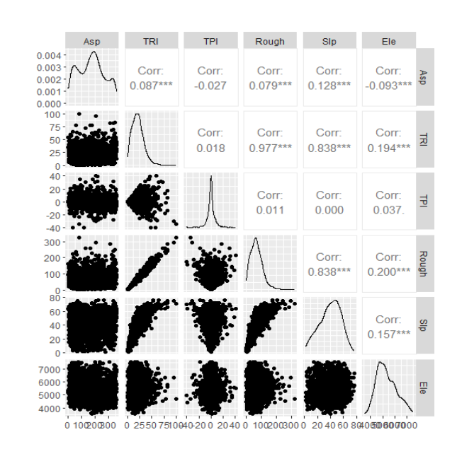
The variables TRI, Roughness and Slope has very high multicollinearity among themselves.
Value of VIF for both TRI and Roughness is pretty high. But once we remove TRI, all other variables are having very less VIF.
Hence, we have removed TRI from our analysis.
Static Variables

Slide 28
Cross
Correlation

Slide 29
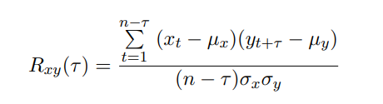
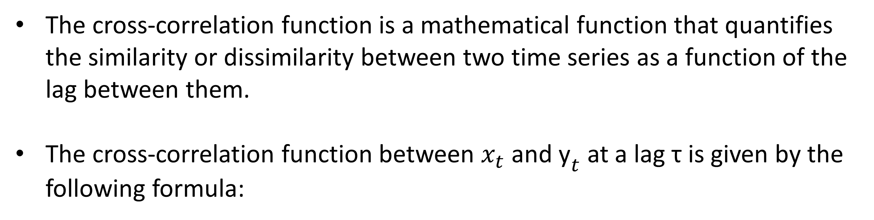
The cross-correlation function is a mathematical function that quantifies the similarity or dissimilarity between two time series as a function of the lag between them.
The cross-correlation function between $x_{t}$ and ${\text{y}}_{t}$ at a lag τ is given by the following formula:
We have checked lags up to order 7 for different elevations for each of the dynamic variables.

Slide 30
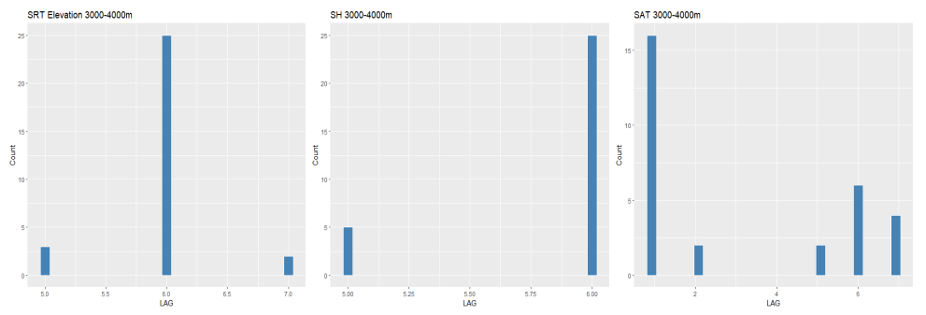
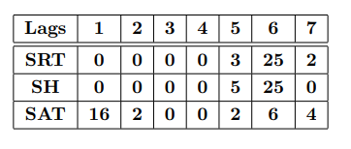
Lags of Dynamic Variables at Elevation 3000-4000m

Slide 31
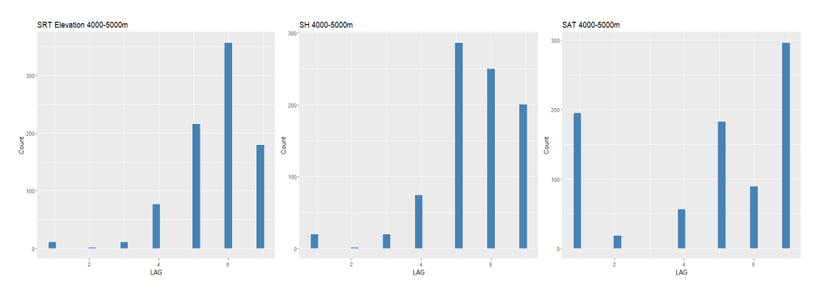
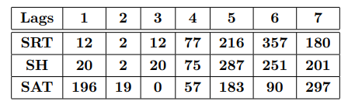
Lags of Dynamic Variables at Elevation 4000-5000m

Slide 32
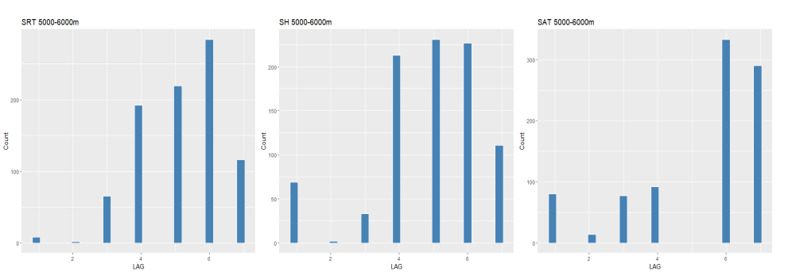
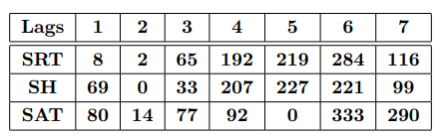
Lags of Dynamic Variables at Elevation 5000-6000m

Slide 33


Lags of Dynamic Variables at Elevation 6000-7000m

Slide 34


Lags of Dynamic Variables at Elevation 7000-8000m

Slide 35


Slide 36

Fitting Machine Learning Models
“All models are wrong, but some are useful.”
-George E. P. Box

Slide 37
Four types of machine learning models were constructed for the purpose of feature selection in modelling our response variable ‘change in snow depth’:
Multiple Linear Regression
Regression Tree
Random Forest
Generalized Boosting.

Slide 38
Multiple Linear Regression
It is a linear regression model which describes the relationship between the response variable and the multiple explanatory variables using a linear function. The equation for multiple linear regression is:
Estimation of a multiple linear regression model is done with the least squares criterion.

Slide 39
Assumptions
The regression model is linear in parameters
The regressors are fixed or measured without error
The mean of errors ε is zero
The errors and regressors are independent
The errors are homoscedastic
The errors are uncorrelated
There is no correlation between the regressors
The no. of observations is greater than no. of parameters
The error ε ~ MVN(0, σ²I_{n})

Slide 40

Verification of Assumptions
“…there never was a straight line, yet with normal and linear assumptions, known to be false, he can often derive results which match…”
-George E. P. Box

Slide 41
Sequence of Verification
We have checked for 2 of the assumptions:
Normality of errors
Homoscedasticity of errors

Slide 42

Normality of Errors
Dynamic Variables
We can visually conclude that the normality assumption does not hold.

Slide 43

Normality of Errors
Static Variables
We can visually conclude that the normality assumption does not hold.

Slide 44

Normality of Errors
Shapiro - Wilk Test
Null hypothesis:
The errors follow normal distribution
Alternative Hypothesis:
The errors does not follow normal distribution
p – Value = 0.04 [for Dynamic Variables]
p – Value = 6.25*${10}^{−16}$ [for Static Variables]

Slide 45

Homoscedasticity of Errors
Residual Plot

Slide 46
Homoscedasticity of Errors
Breusch - Pagan Test
Null hypothesis:
Errors are homoscedastic
Alternative Hypothesis:
Errors are heteroscedastic
p – Value = 0.00767 [for Dynamic Variables]
p – Value = 0.0001794 [for Static Variables]

Slide 47
Summary
Errors are not normally distributed.
Errors are not homoscedastic.
Hence, we cannot use Linear Regression and we will fit non-linear models for feature selection.

Slide 48

Regression
Trees

Slide 49
Key Points
It is a flowchart like structure where internal nodes represent the features of a dataset, branches represent the decision rules and each leaf node represents the outcome.
It is a supervised Machine Learning Algorithm.
The algorithm recursively splits the data into subsets based on the most significant attribute or feature.
The splitting is done in a way that minimizes the variance of the target variable within each subset.

Slide 50
Disadvantages
Regression tree is non-robust which means that a small change in the data can cause a large change in the final estimated tree.
It can cause overfitting.
Hence, we look now for a better model.

Slide 51

Random
Forest

Slide 52
Key Points
It is an ensemble learning method that combines multiple regression trees to make a prediction.
The regression trees are created by drawing a subset of training samples with replacement, called bagging.
Each regression tree in a random forest is built using a different subset of the training data and a different subset of the features.

Slide 53
What’s Next ??..
Boosting trees can be sometimes more accurate than random forests. Because we train them to correct each other's errors, they're capable of capturing complex
patterns in the data.
Hence, next we will fit a Boosted model for feature selection.

Slide 54

Generalized
Boosting
Model

Slide 55
Key Points
It repeatedly fit many decision trees to improve the accuracy of the
model.
For each new tree in the model the input data are weighted in such a way that data that was poorly modelled by previous trees has a higher probability of being selected in the new tree.

Slide 56
Feature
Selection

Slide 57
Note
We have firstly checked by taking both the static and dynamic variables together in a model for feature selection and found out that only the dynamic variables are coming out significant among them which is quite natural for us to expect.

Slide 58

Static Variables
We can interpret that Roughness, Slope, Elevation and Aspect are the most significant static variables.

Slide 59

Dynamic Variables

Slide 60

Dynamic Variables

Slide 61

Dynamic Variables

Slide 62
Dynamic Variables
For each elevation, we have obtained different set of significant predictors and their significant lagged versions.
Now, using the overall significant predictors obtained from these 4 days, we will do our time-series modelling elevation-wise.
We will not use Regression tree for our time-series modelling since it is non-robust.
In place of that, we are going to use a more reputed model known as the Artificial Neural Network.

Slide 63

Artificial
Neural
Network

Slide 64
Key Points
It is based on the structure and functions of the human brain.
The basic building block of an ANN is the artificial neuron, which receives input from one or more sources, applies a mathematical function to the input, and produces an output.
The output of a neuron is determined by the sum of the weighted inputs plus a bias term, which is passed through an activation function.

Slide 65
Prediction
and
Accuracy

Slide 66

From the graphs above, we have chosen 3 locations for which melting is very high and another 3 locations where melting is moderately less and has done our time-series modelling on those.

Slide 67

HIGH MELTING LOCATIONS

Slide 68

LOW MELTING LOCATIONS
Accuracy Measures of ML models done for 3 independent locations

Slide 69
Final Conclusion
Among the static variables, Elevation, Slope, Roughness and Aspect came out to be the most significant.
In case of dynamic variables, if we divide the data elevation-wise, we get different set of significant predictors for our response, and it has varied in between models also.
Our models are performing very good in predicting the desired response when melting is low and performing moderate when melting is very high which can be attributed due to very less data while modelling.

Slide 70
Scope of Future Work
One can surely try out the traditional multivariate time series models for predicting the change in snow depth and can compare those models with the ML models that we have suggested.
One can try out working with other significant dynamic and static variables other than the ones we have used in this project and can compare with our results.

Slide 71
References
Hock, R.,(2003). Temperature index melt modelling in mountain areas. J.Hydrol. 282, 104-115.
Steiner, D., Walter, A. & Zumbuhl, H. J.,(2005). The application of anon-linear back propagation neural network to study the mass balanceof Grosse Aletschgletscher, Switzerland. J. Glaciol. 51, 313-323.
Clarke, G. K. C., Berthier, E., Schoof, C. G. & Jarosch, A. H.,(2009).Neural networks applied to estimating subglacial topography and glaciervolume. J. Clim. 22, 2146-2160.
Maussion, F. et al.,(2019) The Open Global Glacier Model (OGGM) v1.1.Geosci. Model Dev. 12, 909-931.

Slide 72
References
• David Hartmann, Philip Kraaijenbrink, Walter Immerzeel,(2022). Impacts on glacier mass balance in High Mountain Asia assessed using machine learning.
• Zhihua He, Doris Duethmann, Fuqiang Tian,(2021). A meta-analysis based review of quantifying the contributions of runoff components to streamflow in glacierized basins.
• C. Bouchayer, J. M. Aiken, K. ThÃžgersen, F. Renard, T. V. Schuler,(2022). Machine Learning Framework to Automate the Classification of Surge-Type Glaciers in Svalbard.
• Jordi Bolibar, Antoine Rabatel, Isabelle Gouttevin, Harry Zekollari,Clovis Galiez,(2022). Nonlinear sensitivity of glacier mass balance to future climate change unveiled by deep learning.

Slide 73
Acknowledgement
I would like to thank my supervisor Dr. Sarbani Palit for giving me the chance to do this project and for her constant support throughout the project. I would also like to thank Ms. Ayoti Banerjee (SRF GSU ISI, Kolkata) for helping me during collection of data and also helping me understand how QGIS worked without which this project was not possible.

Slide 74
Thank you!
Feel free to approach for any questions.

